Slide 1
Full C# by Fakhr
Zero to hero

Slide 2
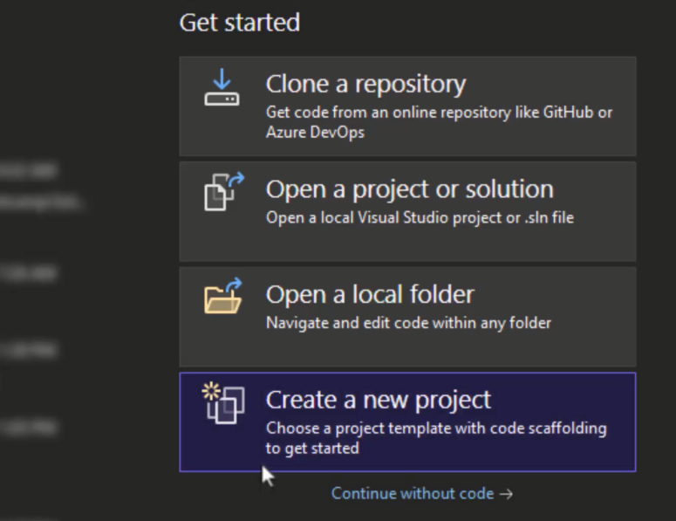
OOP – creating a class – Dice roll game

Slide 3
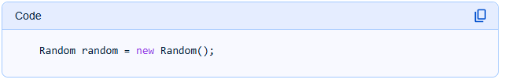
OOP – creating a class – Dice roll game
In C#, random numbers are typically generated using the System.Random class. This class provides methods for generating pseudo-random numbers, meaning they are generated by an algorithm and are not truly random, but appear random for most practical purposes.
Here's how to generate random numbers in C#:
Create an instance of the Random class:

Slide 4
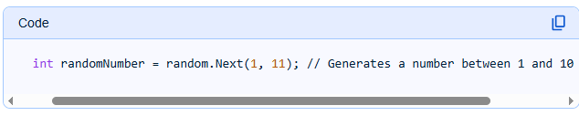
OOP – creating a class – Dice roll game
It is important to create only one instance of Random and reuse it, especially when generating multiple random numbers in quick succession. Creating new instances too close together can result in identical sequences of numbers because the default seed (derived from the system clock) might be the same.
Generate a random integer:
Within a specific range: Use the Next(minValue, maxValue) method. The minValue is inclusive, and the maxValue is exclusive (the generated number will be less than maxValue).

Slide 5
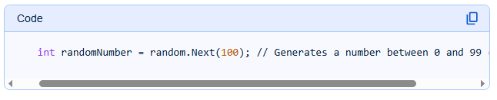
OOP – creating a class – Dice roll game
Non-negative integer less than a specified maximum: Use the Next(maxValue) method. The generated number will be between 0 (inclusive) and maxValue (exclusive).

Slide 6
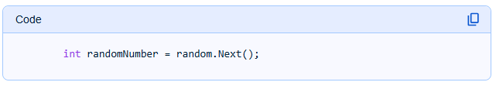
OOP – creating a class – Dice roll game
Any non-negative integer: Use the Next() method without parameters. This generates a random non-negative integer.

Slide 7
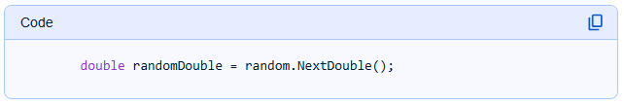
OOP – creating a class – Dice roll game
Generate a random floating-point number (double):
Use the NextDouble() method. This generates a random floating-point number between 0.0 (inclusive) and 1.0 (exclusive).

Slide 8
OOP – creating a class – Dice roll game
For cryptographically secure random numbers, which are necessary for sensitive applications like security and encryption, use the System.Security.Cryptography.RandomNumberGenerator class.

Slide 9
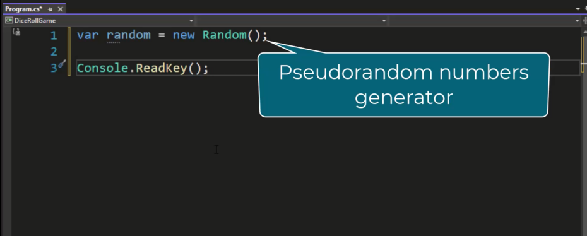
OOP – creating a class – Dice roll game

Slide 10
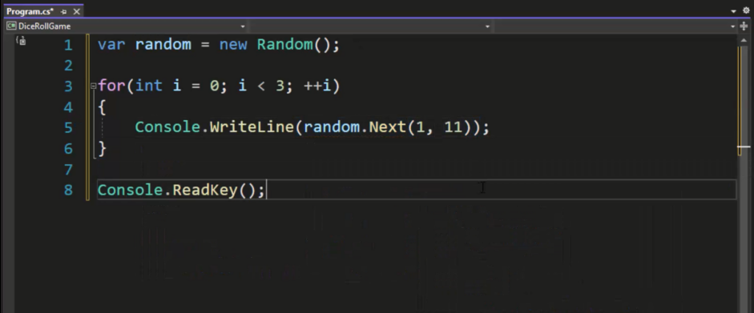
OOP – creating a class – Dice roll game

Slide 11
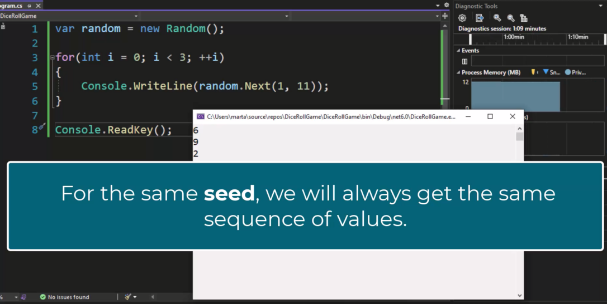
OOP – creating a class – Dice roll game

Slide 12
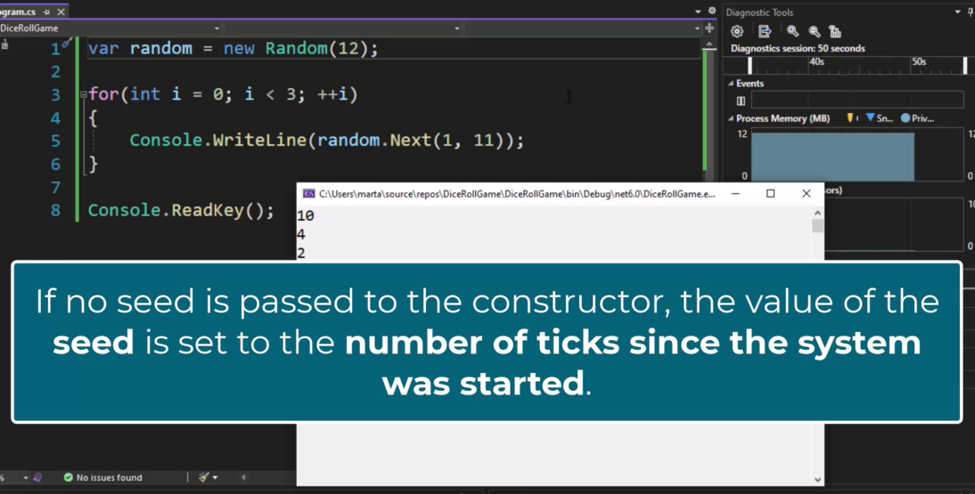
OOP – creating a class – Dice roll game

Slide 13
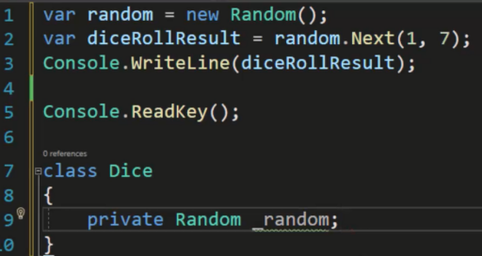
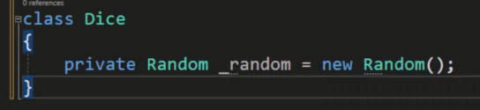
OOP – creating a class – Dice roll game

Slide 14
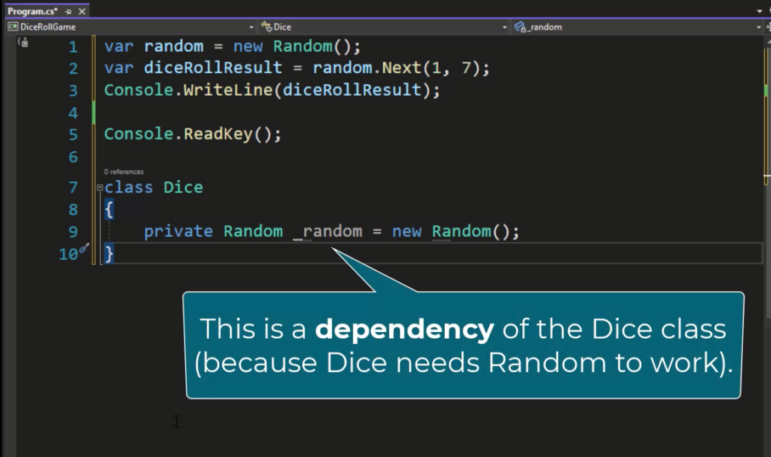
OOP – creating a class – Dice roll game

Slide 15
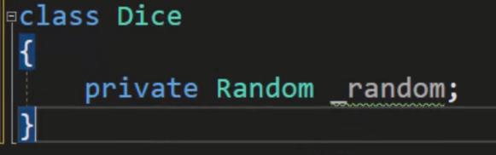
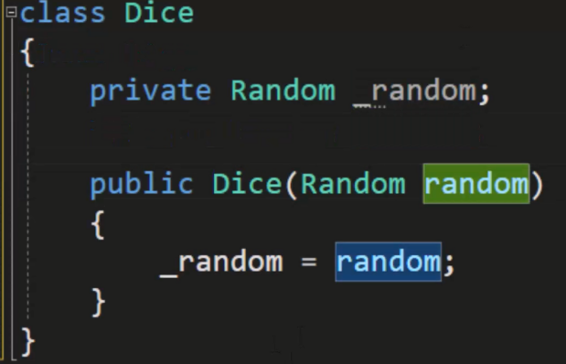
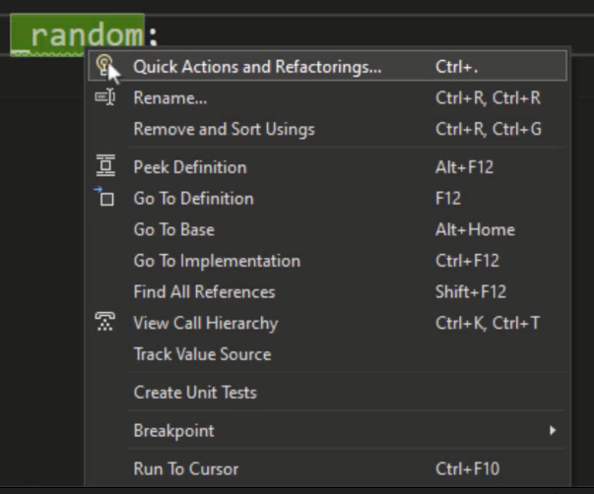
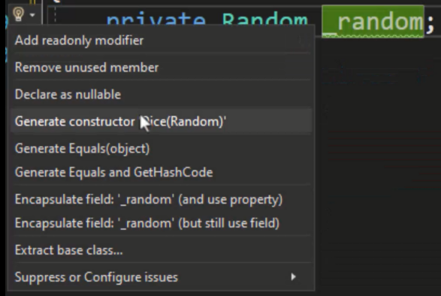
OOP – creating a class – Dice roll game

Slide 16
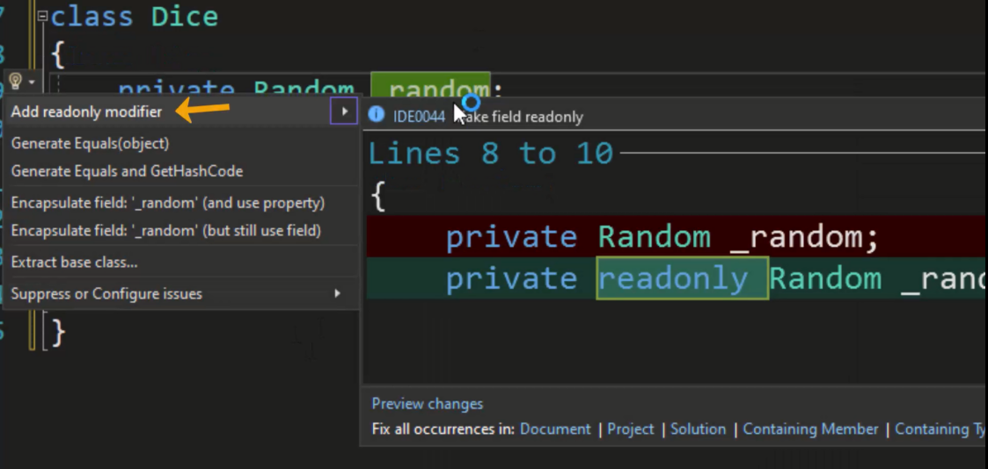
OOP – creating a class – Dice roll game

Slide 17
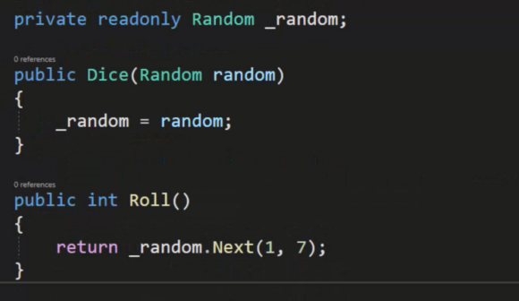
OOP – creating a class – Dice roll game

Slide 18
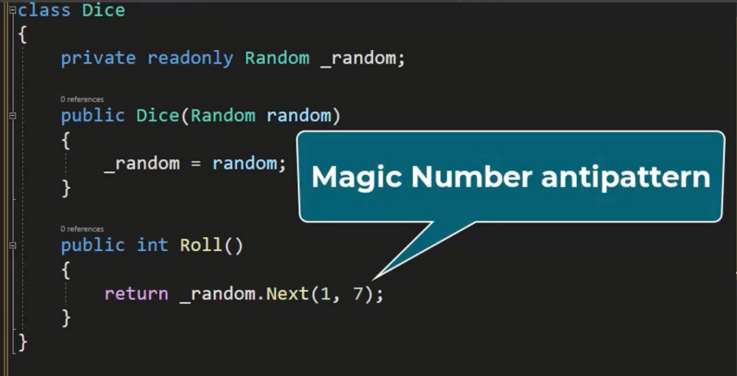
OOP – creating a class – Dice roll game

Slide 19
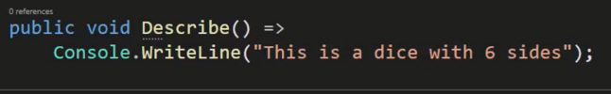
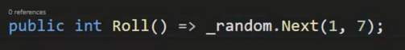
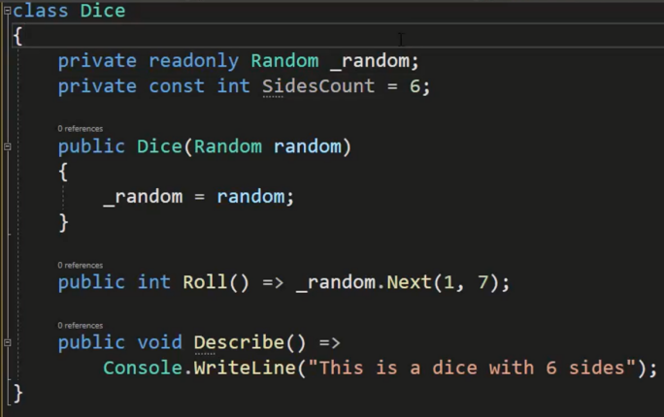
OOP – creating a class – Dice roll game

Slide 20
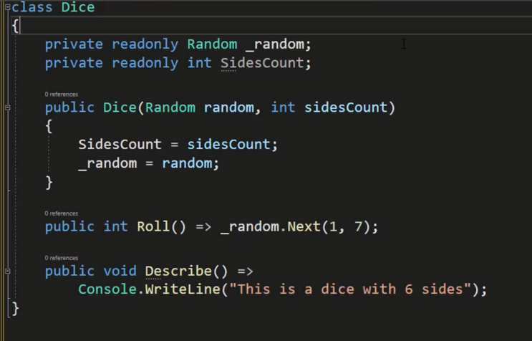
OOP – creating a class – Dice roll game

Slide 21
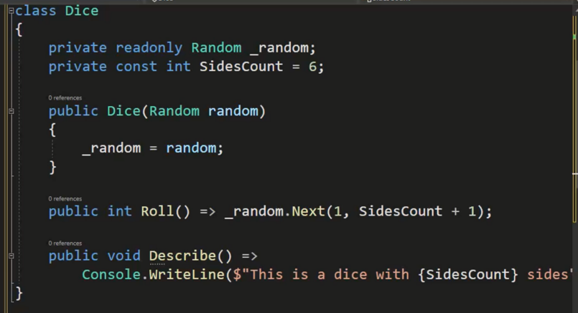
OOP – creating a class – Dice roll game

Slide 22
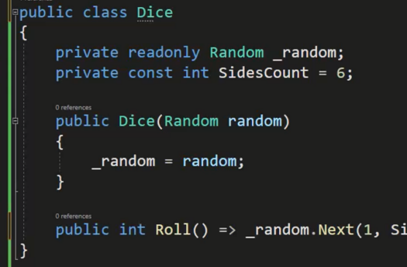
OOP – creating a class – Dice roll game

Slide 23
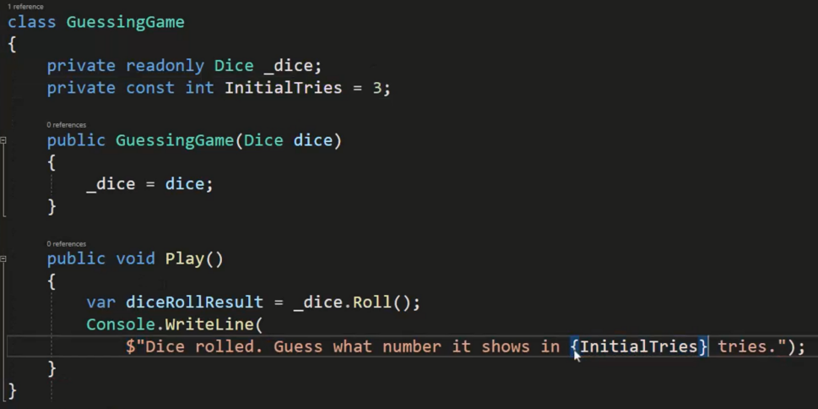
OOP – creating a class – Dice roll game

Slide 24
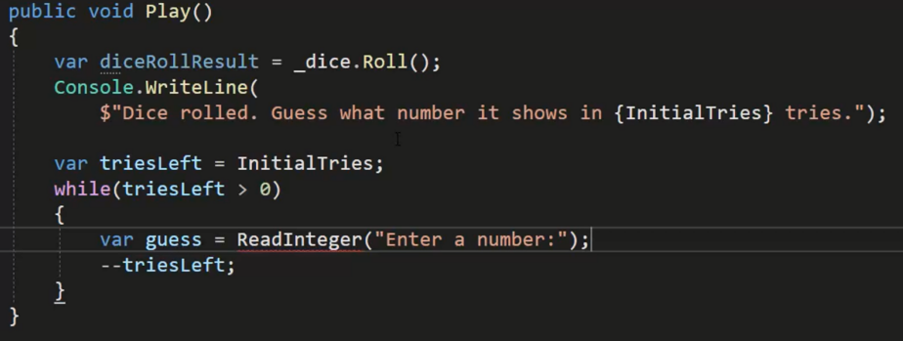
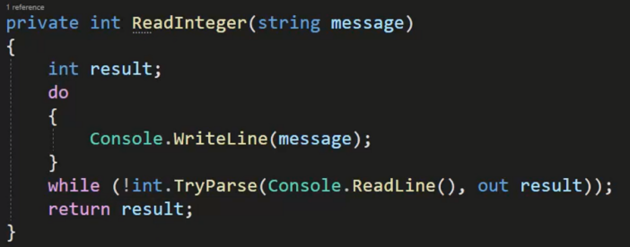
OOP – creating a class – Dice roll game

Slide 25
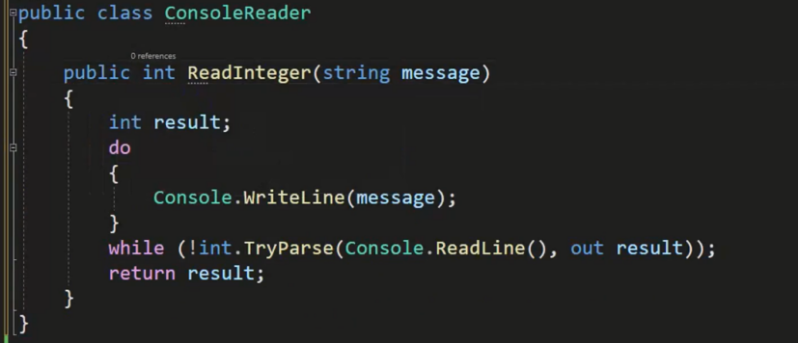
OOP – creating a class – Dice roll game

Slide 26
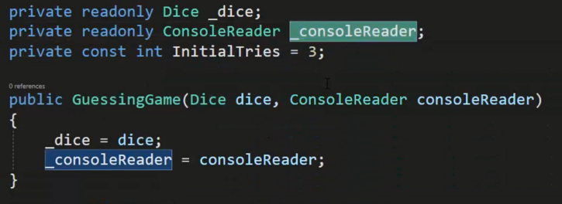
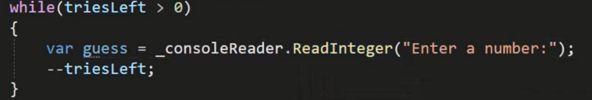
OOP – creating a class – Dice roll game

Slide 27
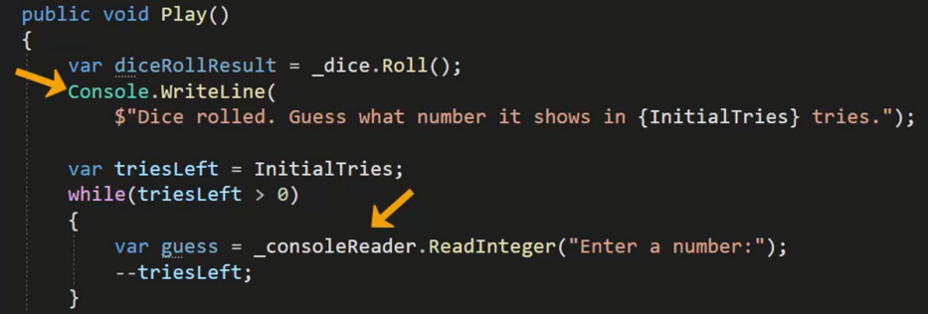
OOP – creating a class – Dice roll game

Slide 28
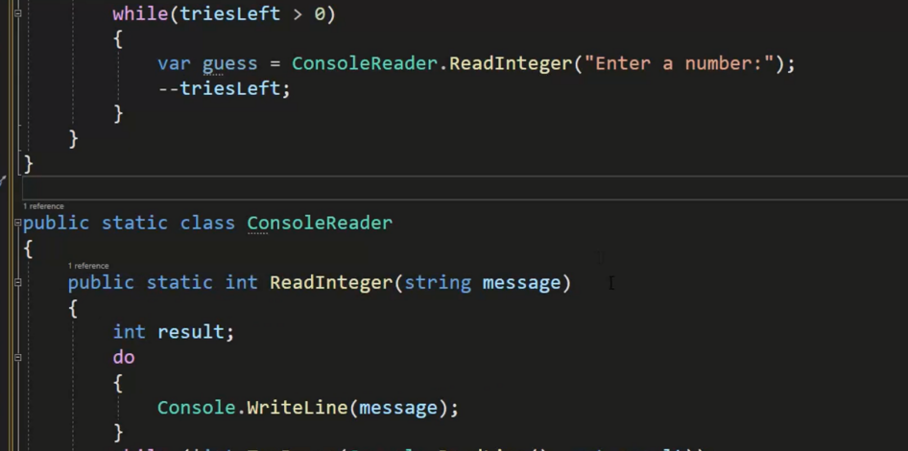
OOP – creating a class – Dice roll game

Slide 29
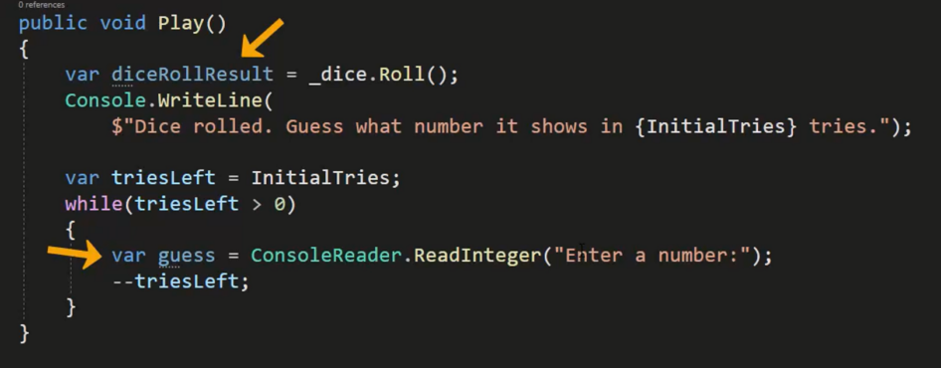
OOP – creating a class – Dice roll game

Slide 30
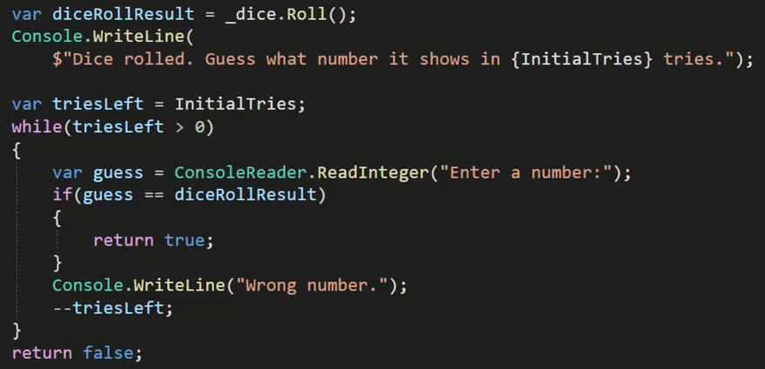
OOP – creating a class – Dice roll game

Slide 31
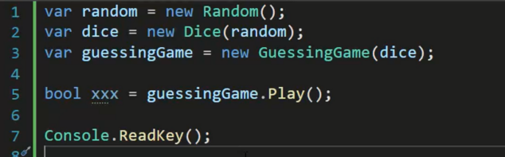
OOP – creating a class – Dice roll game

Slide 32
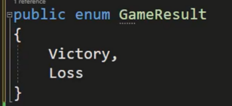
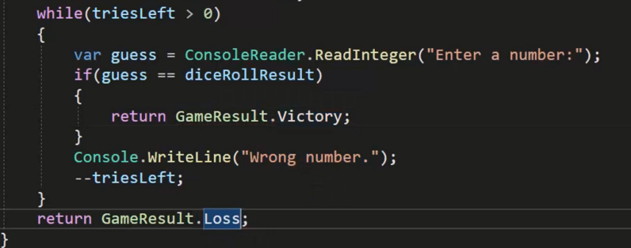
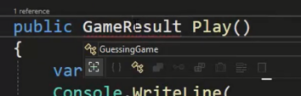
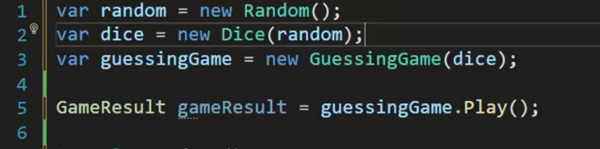
OOP – creating a class – Dice roll game

Slide 33
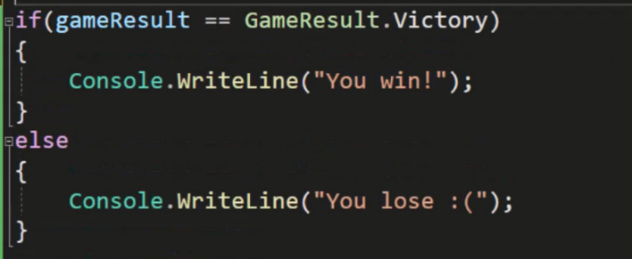
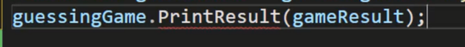
OOP – creating a class – Dice roll game

Slide 34
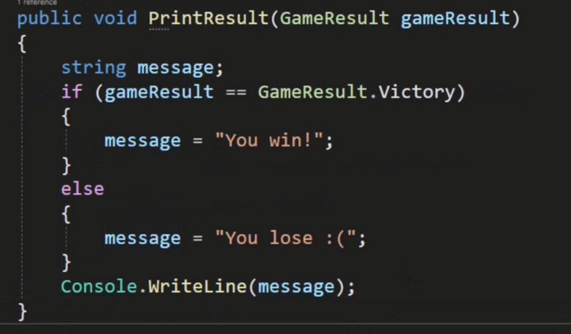
OOP – creating a class – Dice roll game

Slide 35
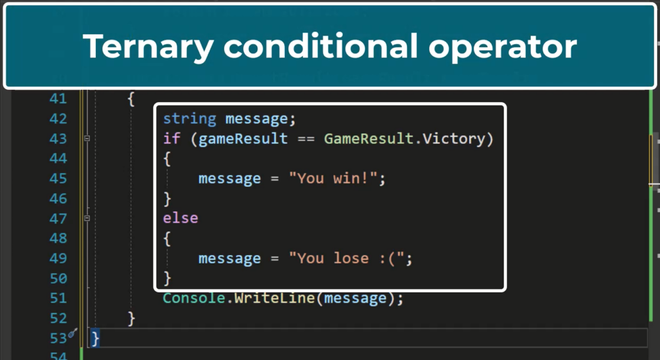
OOP – creating a class – Dice roll game

Slide 36
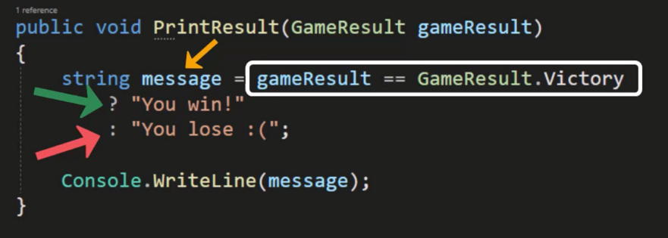
OOP – creating a class – Dice roll game

Slide 37
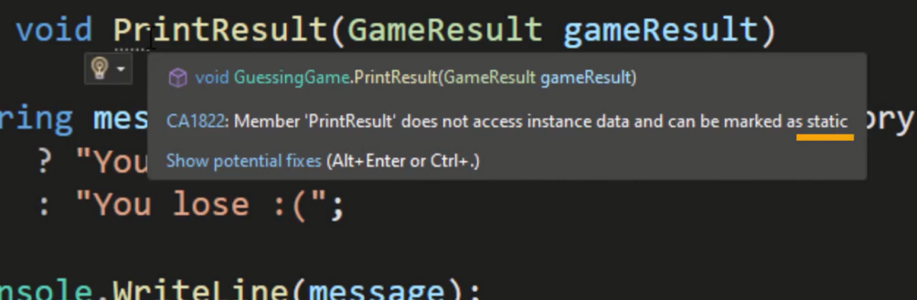
OOP – creating a class – Dice roll game

Slide 38
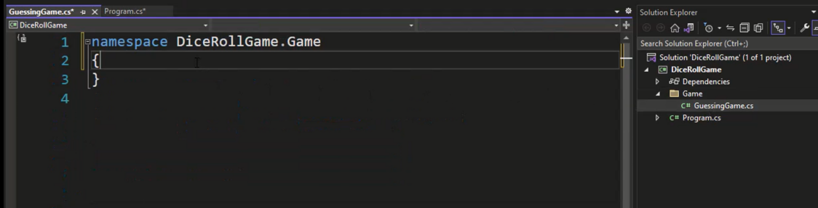
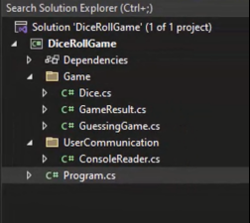
OOP – creating a class – Dice roll game

Slide 39
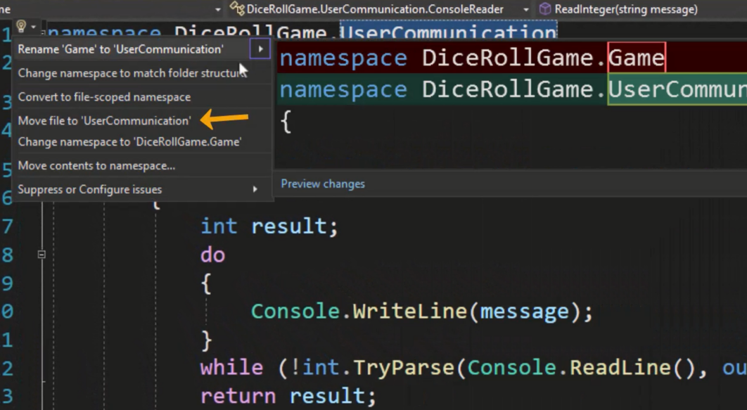
OOP – creating a class – Dice roll game

Slide 40


OOP – creating a class – Dice roll game

Slide 41

Value type – structure

Slide 42

Value type – structure

Slide 43

Value type – structure

Slide 44

Value type – structure

Slide 45

Value type – structure

Slide 46

Value type – structure

Slide 47

Value type – structure

Slide 48

Value type – structure

Slide 49




Value type – structure

Slide 50

Value type – structure

Slide 51

Value type – structure

Slide 52


Value type – structure

Slide 53

Value type – structure

Slide 54



Value type – structure

Slide 55

Value type – structure

Slide 56


Value type – structure

Slide 57

Value type – structure

Slide 58


Value type – structure

Slide 59

Object class – System.Object class

Slide 60


Object class – System.Object class

Slide 61

Object class – System.Object class

Slide 62

Object class – System.Object class

Slide 63


Object class – System.Object class

Slide 64

Object class – System.Object class

Slide 65

Object class – boxing

Slide 66

Object class – boxing

Slide 67

Object class – unboxing

Slide 68

Object class – unboxing

